Slide 1
Fit As A Moose
Reda Bengelloun zahr
Hachem karzazi
Rafii ajana
Amine el kaissi
Hala hijazi

Slide 2
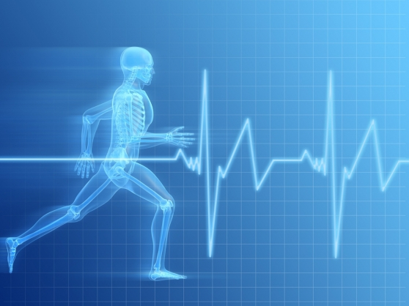

Slide 3
Description
The purpose of this project is to develop an application that ties astronauts on Space Station to health and exercise options as to minimize invasive data collection on Earth. This application would be recording multiple physiological measurements which are: body weight tracking, saliva pH, body temperature, blood pressure, hydration, heartbeats, blood analyzer, breathing control, bone density, safety system, hormone tracking, and sweat measurement.
As we advanced through our work for the project, we made use of numerous pieces of software which are the following: Microsoft Word, SQL Server (as a DBMS), Microsoft Visual Studio, and SketchUp.

Slide 4
The suit
Our idea for this project was designing a comfortable suit equipped with multiple sensors that will keep recording the physiological measurements. Some of those will be measured at the beginning and at the end of the training session, and the others will keep measuring during the training. Moreover, this suit will be wirelessly connected to an application that we implemented.

Slide 5
Our suit will be equipped with a sensor platform called: e-Health Sensor Platform.
This platform is equipped with 10 different sensors that will help us record the physical measurements we are interested in.

Slide 6
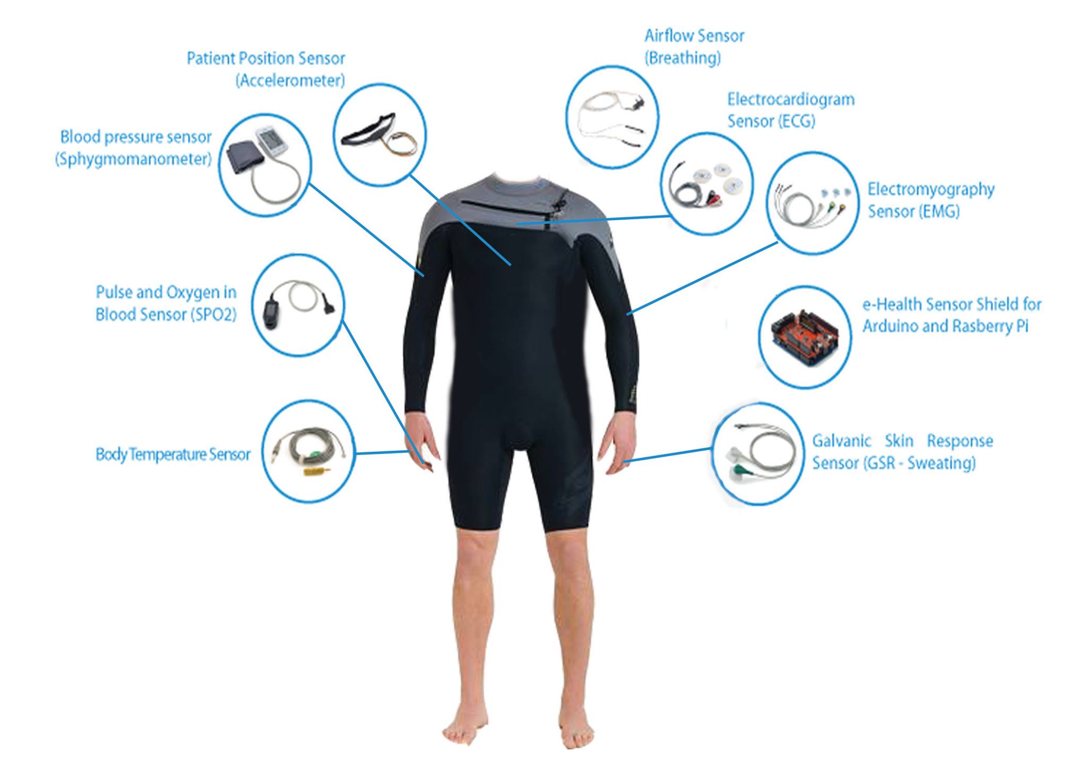

Slide 7
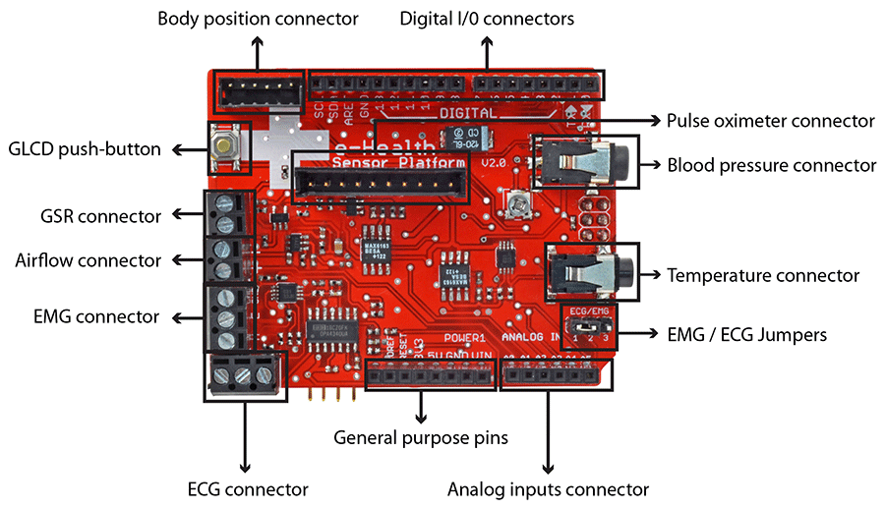
The e-Health Sensor Shield

Slide 8
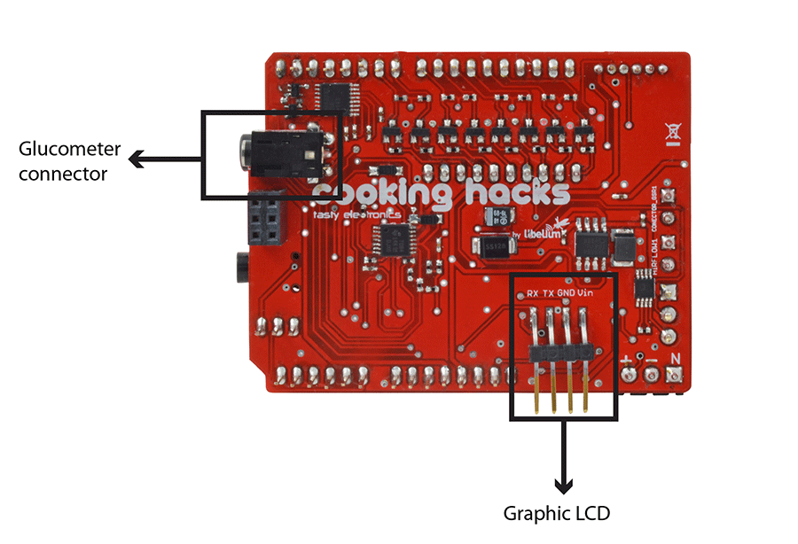

Slide 9
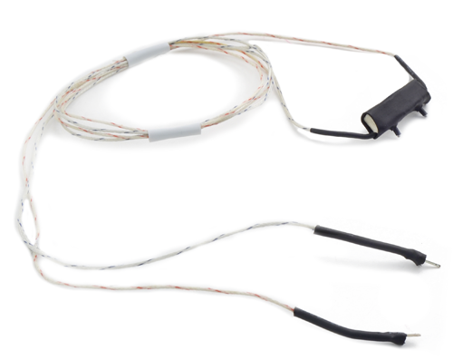
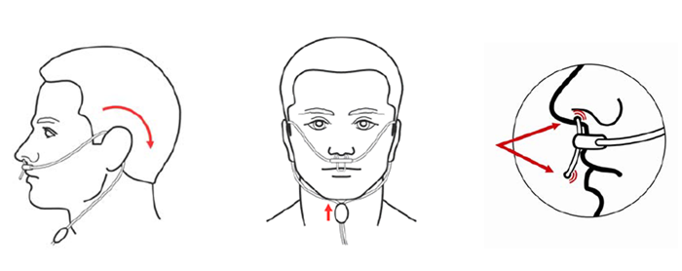
The nasal / mouth airflow sensor is a device used to measure the breathing rate in a patient in need of respiratory help or person. This device consists of a flexible thread which fits behind the ears, and a set of two prongs which are placed in the nostrils. Breathing is measured by these prongs. The specifically designed cannula/holder allows the thermocouple sensor to be placed in the optimal position to accurately sense the oral/nasal thermal airflow changes as well as the nasal temperature air. Comfortable adjustable and easy to install

Slide 10
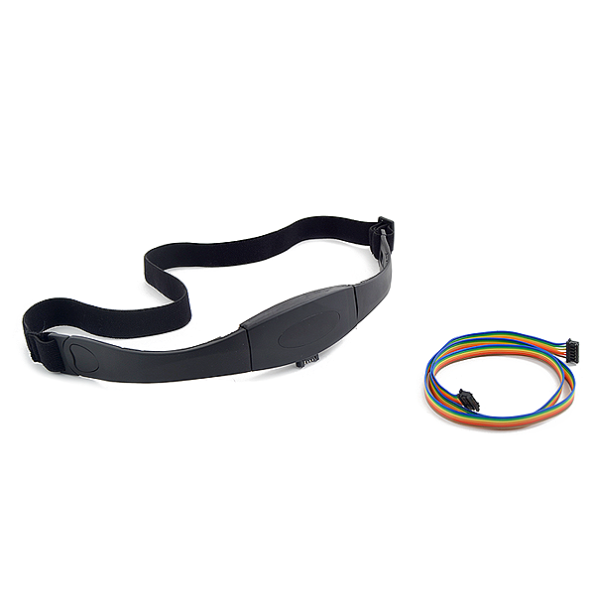
The e-Health Body Position Sensor monitors five different patient positions (standing/sitting, supine, prone, left and right.) In many cases, it is necessary to monitor the body positions and movements made because of their relationships to particular diseases (i.e., sleep apnea and restless legs syndrome). Analyzing movements during sleep also helps in determining sleep quality and irregular sleeping patterns. The body position sensor could help also to detect fainting or falling of elderly people or persons with disabilities.

Slide 11
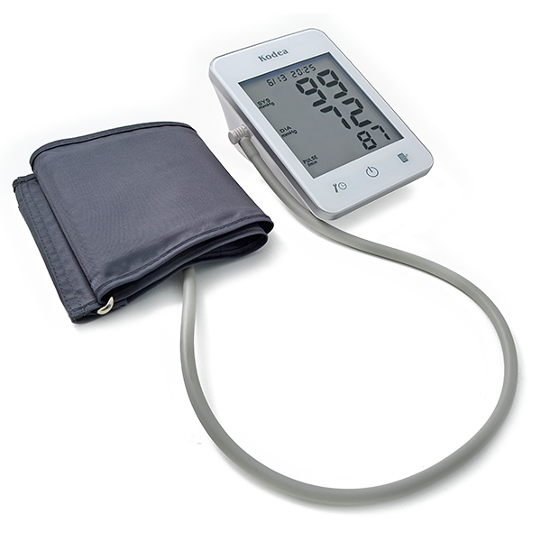
Blood pressure is the pressure of the blood in the arteries as it is pumped around the body by the heart. When your heart beats, it contracts and pushes blood through the arteries to the rest of your body. This force creates pressure on the arteries. Blood pressure is recorded as two numbers—the systolic pressure (as the heart beats) over the diastolic pressure (as the heart relaxes between beats).

Slide 12
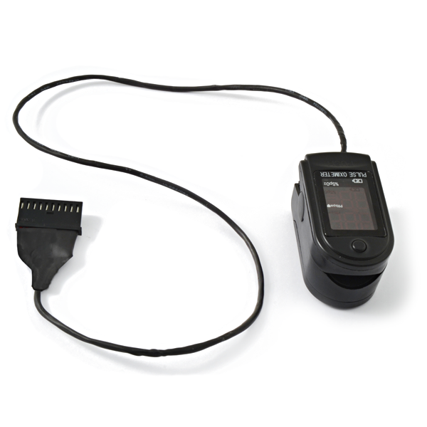
Pulse oximetry a noninvasive method of indicating the arterial oxygen saturation of functional hemoglobin. Oxygen saturation is defined as the measurement of the amount of oxygen dissolved in blood, based on the detection of Hemoglobin and Deoxyhemoglobin. Two different light wavelengths are used to measure the actual difference in the absorption spectra of HbO2 and Hb. The bloodstream is affected by the concentration of HbO2 and Hb, and their absorption coefficients are measured using two wavelengths 660 nm (red light spectra) and 940 nm (infrared light spectra). Deoxygenated and oxygenated hemoglobin absorb different wavelengths.

Slide 13
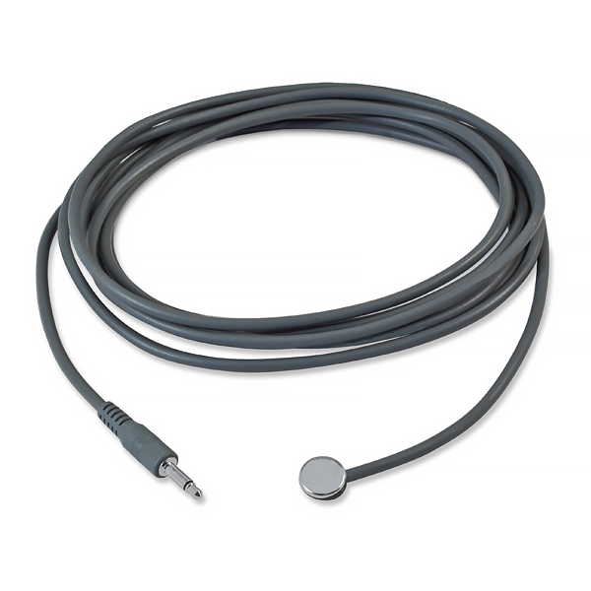
This sensor allows you to measure body temperature. It is of great medical importance to measure body temperature. The reason is that a number of diseases are accompanied by characteristic changes in body temperature. Likewise, the course of certain diseases can be monitored by measuring body temperature, and the efficiency of a treatment initiated can be evaluated by the physician.

Slide 14
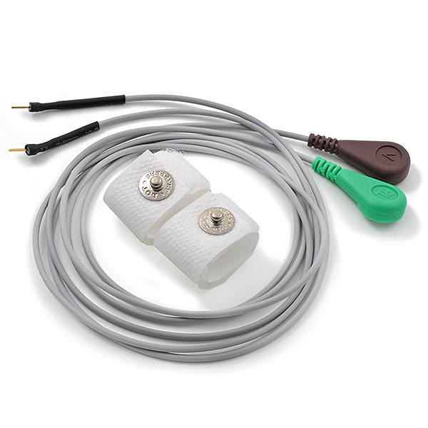
Skin conductance, also known as galvanic skin response (GSR) is a method of measuring the electrical conductance of the skin, which varies with its moisture level. This is of interest because the sweat glands are controlled by the sympathetic nervous system, so moments of strong emotion, change the electrical resistance of the skin. Skin conductance is used as an indication of psychological or physiological arousal, The device measures the electrical conductance between 2 points, and is essentially a type of ohmmeter.

Slide 15
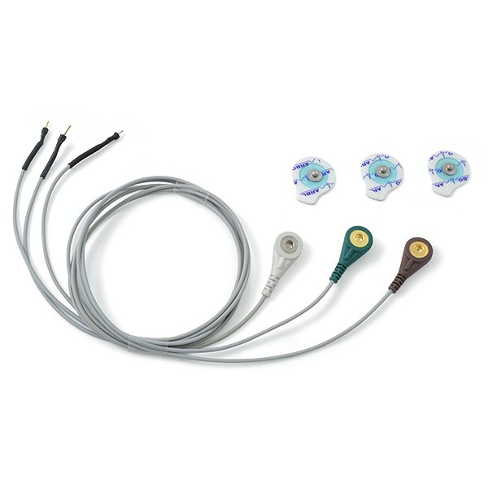
An electromyogram (EMG) measures the electrical activity of muscles at rest and during contraction. EMG signals are used in many clinical and biomedical applications. EMG is used as a diagnostics tool for identifying neuromuscular diseases, assessing low-back pain, kinesiology, and disorders of motor control. EMG signals are also used as a control signal for prosthetic devices such as prosthetic hands, arms, and lower limbs

Slide 16
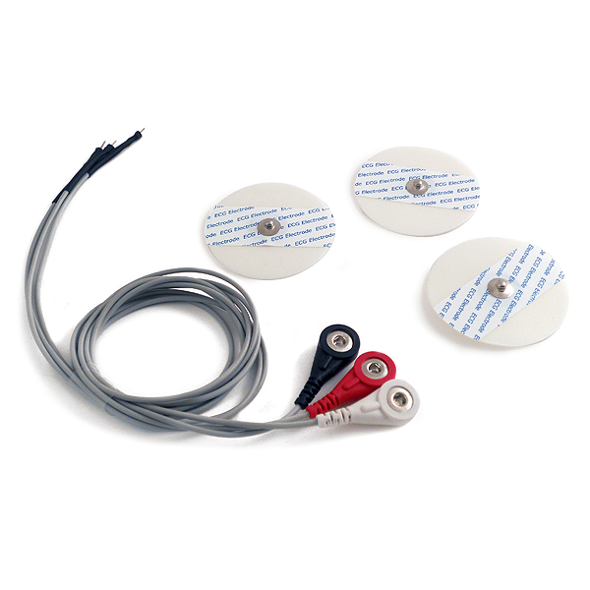
The electrocardiogram (ECG or EKG) is a diagnostic tool that is routinely used to assess the electrical and muscular functions of the hear. The electrocardiogram (ECG) has grown to be one of the most commonly used medical tests in modern medicine. Its utility in the diagnosis of a myriad of cardiac pathologies ranging from myocardial ischemia and infarction to syncope and palpitations has been invaluable to clinicians for decades.

